Slide 1
Evolutionary Algorithms for Solving Multiobjective Constrained Optimization Problems
Yong Wang
School of Automation
Central South University
ywang@csu.edu.cn
https://intleo.csu.edu.cn/

Slide 2

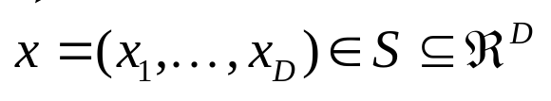




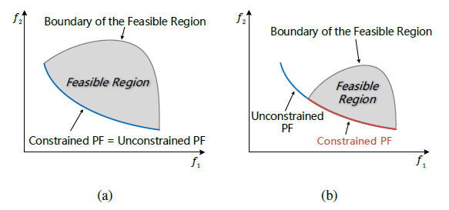
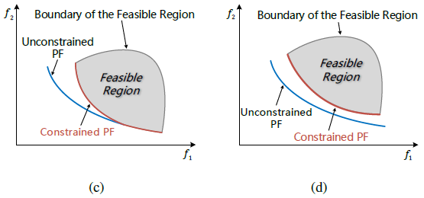
Multiobjective Constrained Optimization Problems (1/2)
The multiobjective constrained optimization problems (MCOPs) can be formulated as follows:
minimize
subject to
inequality constraints
equality constraints
PF: Pareto Front
Challenges:
1) Current test problems are not well-designed (e.g., large feasibility ratio)
2) Current methods cannot well converge to the Pareto front

Slide 3
Multiobjective Constrained Optimization Problems (2/2)
Some artificial multiobjective constrained functions have been proposed:
  CTP functions proposed by Deb et al.
  CF functions proposed by Zhang et al.
  C-DTLZ functions proposed by Jain et al.
  NCTPs functions proposed by Li et al.
  DAC-MOP1-15 functions proposed by Fan et al.

Slide 4
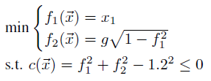

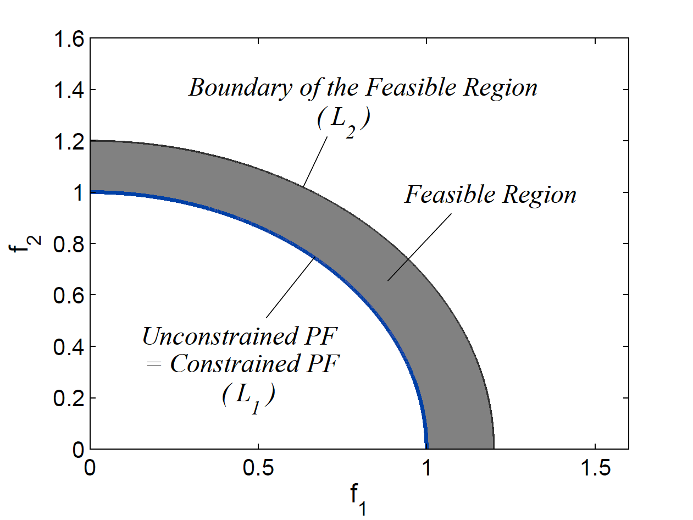



Test Suite I —— MW (1/5)
MW contains a global control process and a local adjustment process
Step 1: Global Control Process
1
Select a set of similar functions
2
Produce an unconstrained Pareto front
Produce an inequality constraint
Z. Ma and Y. Wang. Evolutionary constrained multiobjective optimization: Test suite construction and performance comparisons. IEEE Transactions on Evolutionary Computation, vol. 23, no. 6, pp. 972-986, 2019.

Slide 5
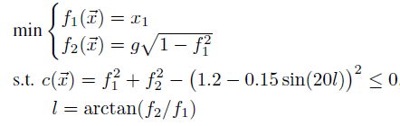

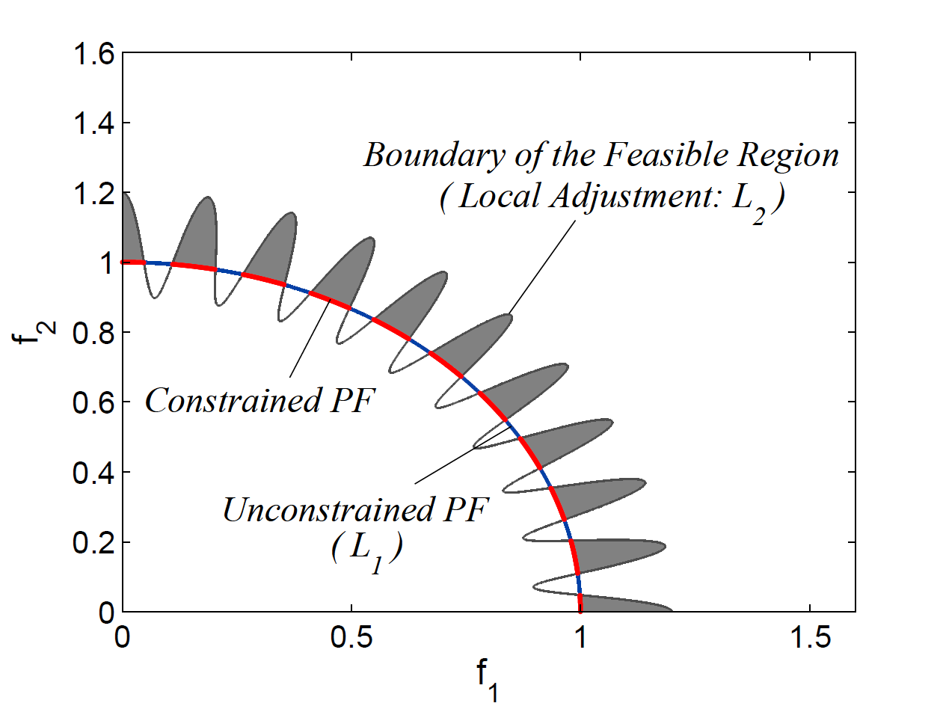

Test Suite I —— MW (2/5)
MW contains a global control process and a local adjustment process
Step 2: Local Adjustment Process
Introduce the following periodic function into the constraint

Slide 6
Test Suite I —— MW (3/5)
Characteristics
  Small and controllable feasibility ratio
  Sufficient nonlinearity in terms of constraints
  Diverse geometries of constrained Pareto fronts
  If the global control process involves several similar functions, we can construct test problems that has multiple constraints

Slide 7
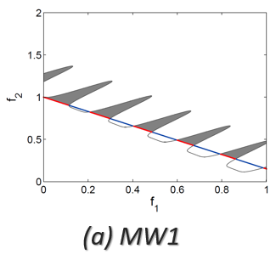
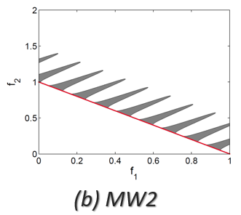
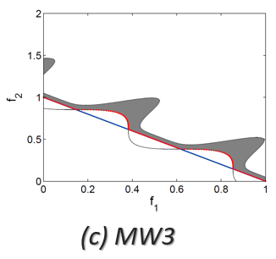
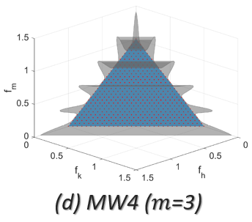
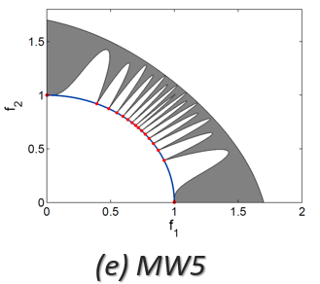
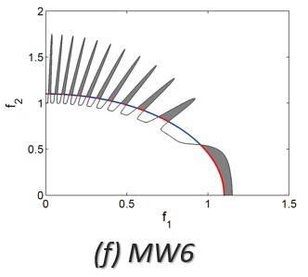
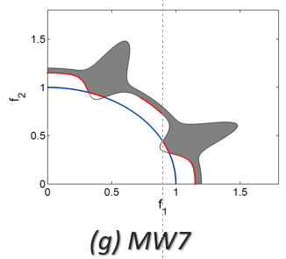
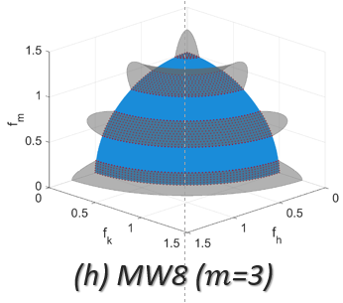
Test Suite I —— MW (4/5)

Slide 8
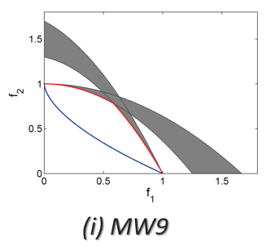
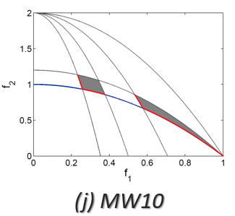
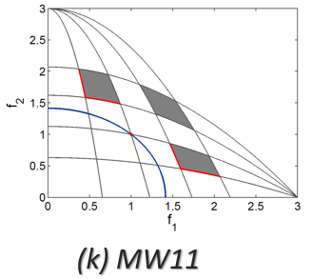
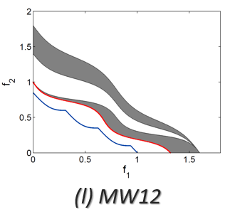
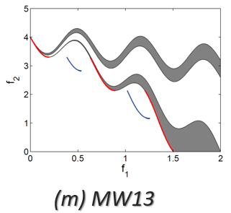
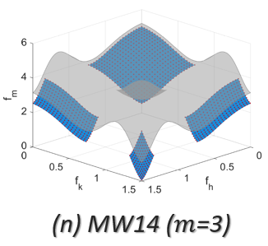
Test Suite I —— MW (5/5)

Slide 9
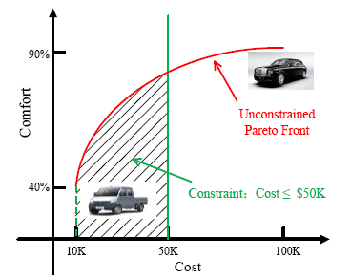
Test Suite II —— DOC (1/5)
The decision constraints and objective constraints usually coexist in real-world MCOPs.
However, they are never considered simultaneously in the design of current artificial MCOPs. Thus these MCOPs may have a limited capability to simulate practical scenes.
Z.-Z. Liu and Y. Wang. Handling constrained multiobjective optimization problems with constraints in both the decision and objective spaces. IEEE Transactions on Evolutionary Computation, vol. 23, no. 5, pp. 870-884, 2019.

Slide 10
Test Suite II —— DOC (2/5)
DOC contains three main parts
  An unconstrained multiobjective optimization problem
  Constraints in the objective space
  Constraints in the decision space

Slide 11
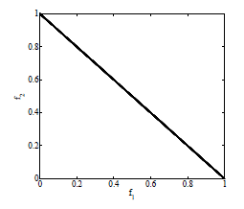

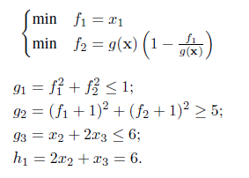
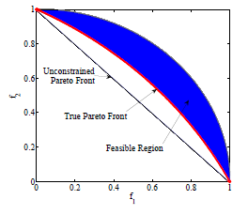

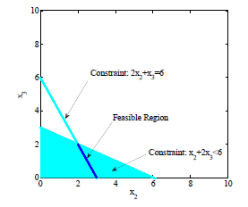

Test Suite II —— DOC (3/5)
An unconstrained multiobjective optimization problem
objective constraints
decision constraints

Slide 12
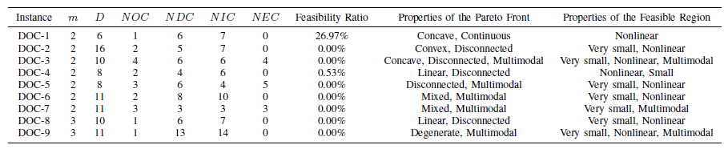
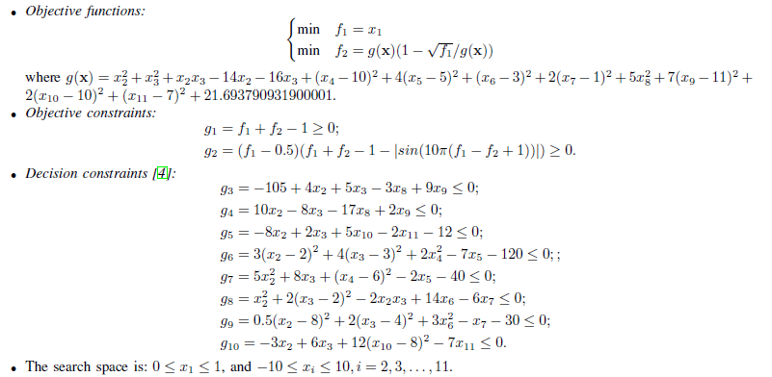
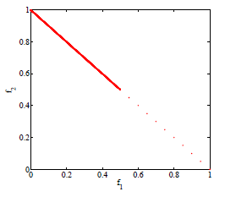
Test Suite II —— DOC (4/5)

Slide 13
Test Suite II —— DOC (5/5)
Characteristics
  Various decision constraints (e.g., inequality constraints, equality constraints, linear constraints, and nonlinear constraints) are collected from real-world applications, thus making the feasible region in the decision space have different properties (e.g., nonlinear, extremely small, and multimodal).
  Some simple and controllable objective constraints are devised to reduce the feasible region in the objective space and to make the Pareto front have diverse characteristics (e.g., continuous, discrete, mixed, and degenerate).
  As a whole, DOC poses a great challenge for a constrained multiobjective EA to obtain a set of well-distributed and well-converged feasible solutions.

Slide 14
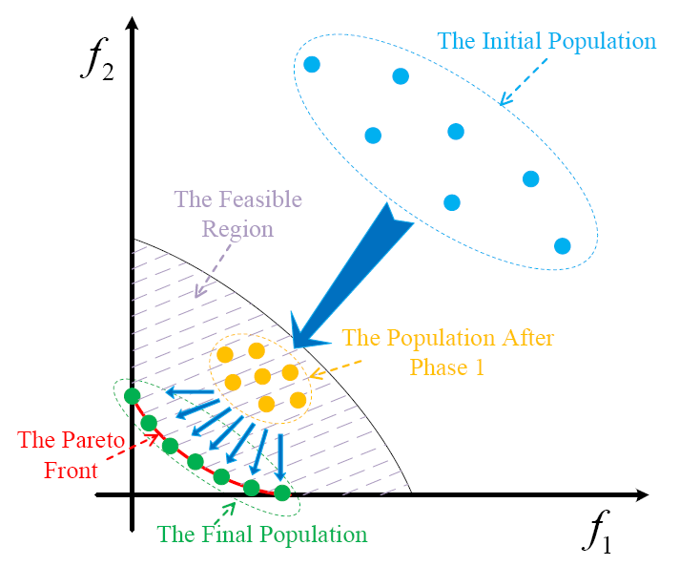
ToP (1/3)
A simple and efficient two-phase framework

Slide 15
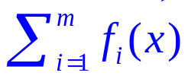
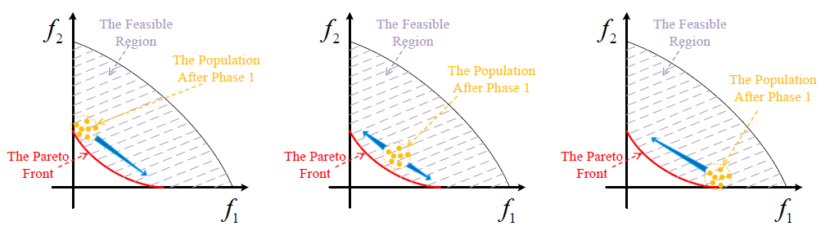
ToP (2/3)
In the first phase, a MCOP is transformed into a SCOP by ignoring the conflicting among the objective functions
minimize
minimize
subject to
subject to
This transformation not only leads to faster convergence speed but also alleviates the premature convergence inside the feasible region.

Slide 16
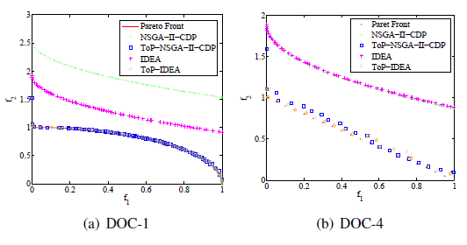
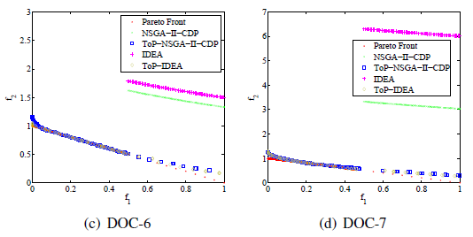
ToP (3/3)
In the second phase, a specific multiobjective EA is implemented to obtain the final solutions.
In principle, any multiobjective EA is applicable in the second phase.

Slide 17
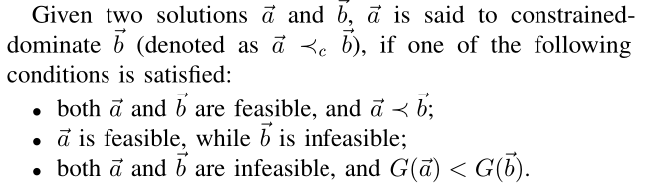
ToR (1/7)
Motivation
  Among the constraint-handling techniques in constrained multiobjective optimization, constrained dominance principle (CDP) is simple, flexible, non-parametric, and easy to be embedded into multiobjective evolutionary algorithms.
  However, CDP always prefers constraints to objectives, which tends to cause premature convergence.
CDP
K. Deb, A. Pratap, S. Agarwal, and T. Meyarivan. A fast and elitist multiobjective genetic algorithm: NSGA-II. IEEE Transactions on Evolutionary Computation, vol. 6, no. 2, pp. 182-197, 2002.

Slide 18
ToR (2/7)
The main idea
  The fitness function of each solution is defined as the weighted sum of two rankings: one is the solution’s ranking based on CDP and the other is the solution’s ranking based on Pareto dominance (i.e., without considering any constraint).
Z. Ma, Y. Wang, and W. Song. A new fitness function with two rankings for evolutionary constrained multiobjective optimization. IEEE Transactions on Systems, Man, and Cybernetics: Systems, vol. 51, no. 8, pp. 5005-5016, 2021.

Slide 19
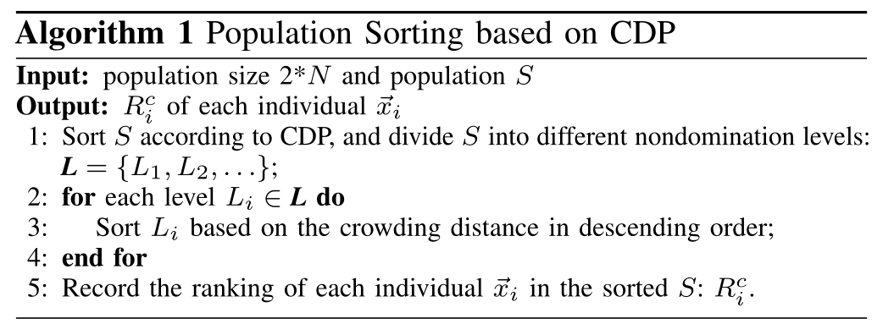


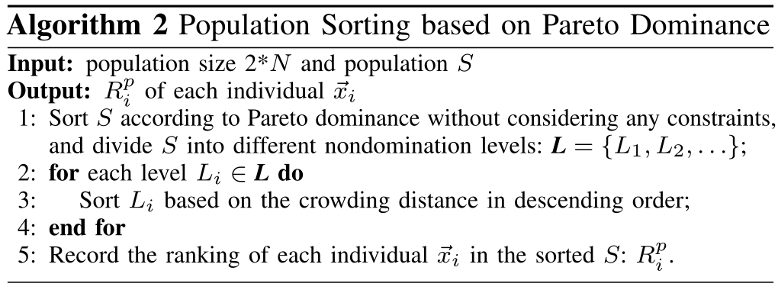
ToR (3/7)
P_{fea} denotes the proportion of feasible solutions, which adaptively reflects the status of the population during the evolution, we utilize it to achieve the balance between constraints and objectives.

Slide 20
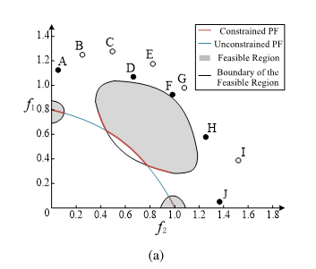
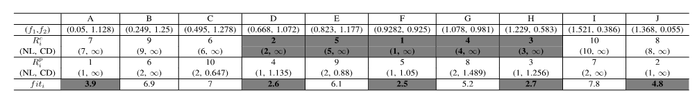
ToR (4/7)
The first example

Slide 21
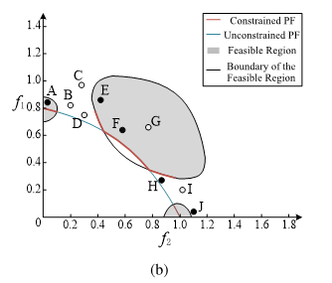

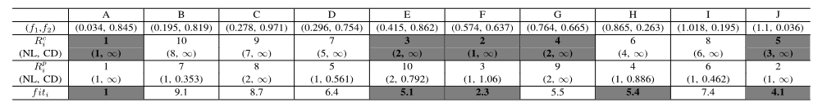
ToR (5/7)
The second example

Slide 22
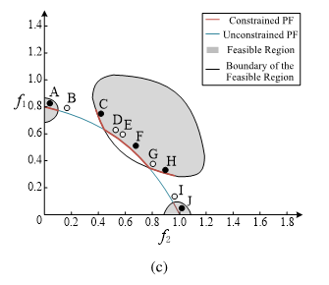
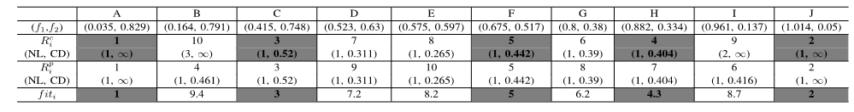
ToR (6/7)
The third example

Slide 23
ToR (7/7)
Characteristics
  Due to the population sorting based on Pareto dominance, ToR is able to utilize the information of objectives, thus saving some promising infeasible solutions.
  These infeasible solutions are useful to explore new areas of the feasible region and to approach the Pareto optimal solutions located on the boundary of the feasible region from the infeasible side.
  As P_{fea} approaches to 1, ToR is similar to CDP, which ensures the sufficient number of feasible solutions. This characteristic is very important for constrained multiobjective optimization since infeasible solutions are undesirable in the end.

Slide 24


